Slide 1
Communication Theory and Interventions
Feb 6 2025

Slide 2

Ribbon of Change
What is one thing you want to change about the world? (1 min)
Please hold on to your end of the ribbon after you answer
Pass this to another person in the room to respond
Imagine that this ribbon represents resources (time, effort, funding, capacity, expertise etc.)

Slide 3
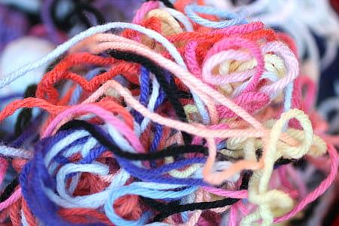
Debrief
How do you feel when hearing other people’s “Change the world”?
If they succeed, how would this change impact you?
Would you be interested to contribute to those changes?
Notes:
We are all connected by this “Web of Change”.
This symbolizes how we have individual concerns that is connected to everyone too.
One person’s issues are everyone’s.
A problem is a problem even if it isn’t happening to you.

Slide 4
Key themes from this week’s readings/reflections
Time Constraints for Relationship Building
Balancing Research with Action goals (and making it fun & engaging)
Utilizing Digital & Traditional Approaches
Balancing Individual vs. Structural Change - what are levers of change among youth?

Slide 5
Individual Reflection
(8 minutes)
Each person writes one concrete solution or strategy for each theme
E.g.,: Under "Time Constraints & Relationship Building" - "Start each session with a relationship-building icebreaker for 5-10 minutes"
Keep ideas specific and actionable

Slide 6
Key themes from this week’s readings/reflections
Time Constraints for Relationship Building
Balancing Research with Action goals (and making it fun & engaging)
Utilizing Digital & Traditional Approaches
Balancing Individual vs. Structural Change - what are levers of change among youth?

Slide 7
Discuss in pairs or groups of 3 (15 minutes)
Long-term Impact
Place your combined solutions in the appropriate quadrants
Discuss why you place each solution where you did
Share out: Top 2-3 solutions (e.g., one high impact and one easy to implement) from your group
Short-term Impact
Easy to implement
Challenging to implement

Slide 8
Debrief
Common themes across the three small groups
What are specific ideas we can incorporate in future engagement sessions?

Slide 9
Plus/Delta
Plus
Delta

Slide 10
Break

Slide 11
Planning for Make-up Engagement Session
Can we offer another day we can all attend Ms. Schwalm’s class for a make-up session to stay on track?
Next Wed: Agenda for session #2 - any modifications based on today’s discussions?
Building trust & relationship
Clarify with youth what are the shared goals from our engagement
What are some action goals or research products to aim for?
Others?

Slide 12
Planning Engagement Session #3 (Feb 26)
Preparing for session 3 (facilitated by Penn students)
Originally focused on brainstorming problems and potential solutions
Outline of planned engagement session #3
E.g., Activity to identify local initiatives and success stories with youth?
Drawing from Stepping Stones and other examples
What materials do we have to prepare?

Slide 13
Next Week
Engagement session #2 - meet at ~9.15am
Thursday - Ethical considerations in YPAR and health comm

